Slide 1
Designing for People with Cognitive Disabilities (and Everyone Else)
Rachael Bradley Montgomery, PhD
Digital Accessibility Architect

Slide 2
Goals of this talk
Humanize and diversify “cognitive and learning disabilities”
Introduce design patterns that support people with cognitive and learning disabilities

Slide 3
Agenda
Background
Personas
Design Patterns
Design Guide and System
Questions

Slide 4
Background

Slide 5
Functional needs: Cognitive & learning disabilities
Functional need (Use with limited…) | Example disabilities with these needs
Attention | Attention Deficit (Hyperactivity) Disorder
Language and Literacy | Aphasia, Dyscalculia
Learning | Brain Injury, Dyslexia
Memory | Age Related Forgetfulness, Mild Cognitive Impairment
Executive | Brain Injury, Autism
Mental Health | Anxiety, Post Traumatic Stress Disorder
Link: DRAFT Functional Needs

Slide 6

Related situational or temporary disabilities
Fatigue
Stress
Distraction
Using foreign languages or measurements
Notes:
Image credit: Elisa Ventur

Slide 7
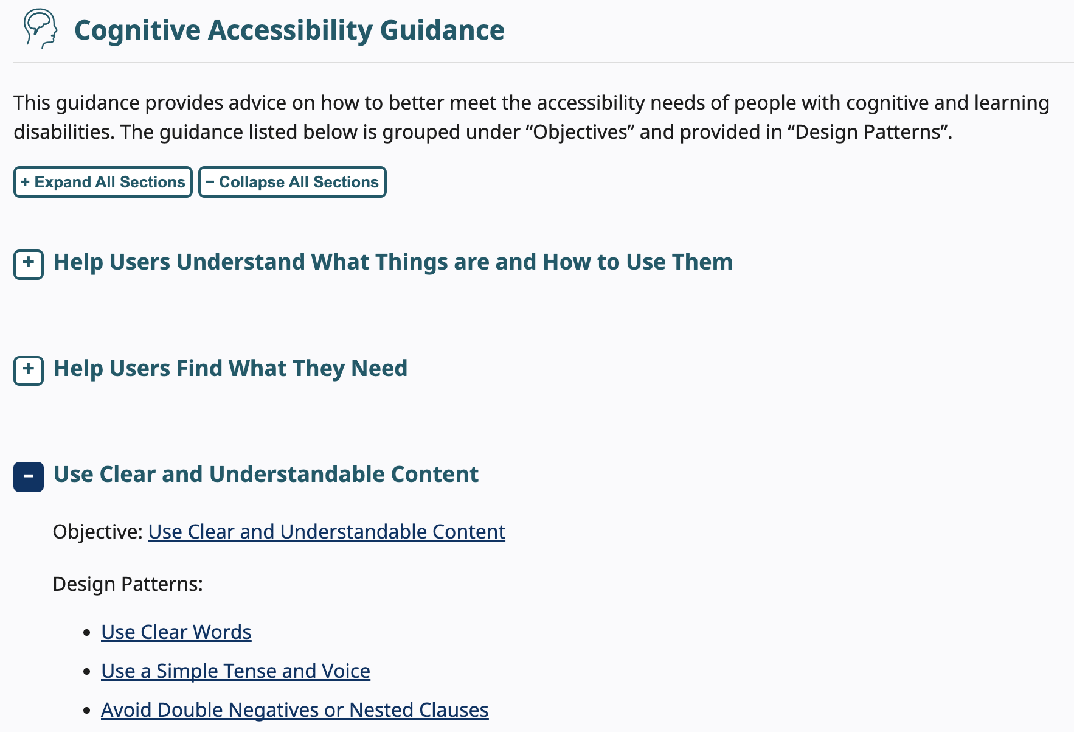
Making content usable for people with cognitive & learning disabilities
Document link
https://www.w3.org/TR/coga-usable
Web link https://www.w3.org/WAI/WCAG2/supplemental/#-cognitive-accessibility-guidance

Slide 8
Objectives
Help users understand what things are and how to use them
Help users find what they need
Use clear and understandable content
Help users avoid mistakes and know how to correct them
Help users focus
Ensure processes do not rely on memory
Provide help and support
Support adaptation and personalization

Slide 9
Personas

Slide 10

Alison: Aging user with mild cognitive impairment
Problem: I’m not sure what I should press. I pressed something that looked like the “buy” button but it did nothing. I am not sure if it is me or if this web site just doesn’t work.
Works well: The “buy” button was clearly something I could click. The process was easy. I have now bought matching dresses for all the grandchildren.
Sample user needs
Use a familiar hierarchy and design
Use a consistent visual design
Clearly identify controls and their use
Make the relationship clear between controls and the content they affect
Provide human help
Make it easy to find help and give feedback
Notes:
Her Story
Alison has a medical background, working in rehabilitation of physical injuries.
She recently decided to work part-time to take up more hobbies and be with her grandchildren.
She wants to try an online course to learn Chinese, in preparation for a special holiday. Alison considers 63 to be the new 36. However, she has difficulty concentrating and finding the word she wants to say.
She often makes typos and has to correct sentences when she re-reads them. She becomes easily frustrated as she finds new technical things, like updated design patterns and applications, hard to learn and less intuitive than they used to be.
Plus, navigation takes longer than in the past.
Unfortunately, this includes learning how to use a new interface and this affects the way she works when swapping between her tablet, phone, and computer.
Mild Cognitive Impairment (MCI) can involve problems with memory, language, thinking, and judgment that are greater than normal age-related challenges. It is sometimes considered the stage between the common and expected age related forgetfulness and the more serious decline of dementia, although many or most people with MCI will not develop dementia.
Image credit: Christian Buehner on unsplash.com

Slide 11

Kwame: A traumatic brain injury survivor
Problem: I got lost making a shopping order and I wanted to go back to the previous step. I hit the back button on the browser navigation bar and it reloaded the home page. I had to start all over again.
Works well: There is a clear back button on each step and when I use the browser back button it also works.
Sample User Needs:
Provide Search
Make the site hierarchy easy to understand and navigate
Use a clear and understandable page structure
Help the user stay safe
Limit interruptions
Avoid too much content
Provide information so a user can complete and prepare for a task
Make short critical paths
Make the purpose of your page clear
Notes:
His Story
Kwame was involved in a very serious car crash that left him with some physical, sensory, and cognitive and learning disabilities having sustained a brain injury.
He has returned to work. However, he often finds conversations are strained due to difficulties with memory recollection and visual understanding.
Kwame learnt how to walk, talk, and live life all over again.
Medical experts informed him that his greatest chances for recovery would take place within the first 2 years after his injury. After that he may continue to recover, but at a much slower, and incremental rate.
His friends and family are amazed by how quickly he has regained his ability to speak, and perform his daily life functions. They are confused by all of the cognitive difficulties he says he is having, despite his ability to articulate and communicate.
For example, he often cannot recognize images and faces. He gets disorientated in physical spaces. He often gets lost in rooms, as well as buildings, larger places, documents, and web sites.
He has returned to his old company as a researcher and is back using applications and the internet throughout his working day.
Image credit: Hust Wilson on unsplash

Slide 12

Gopal: Retired lawyer with dementia
Problem: I want to turn the volume up but there is no dial?
Works well: There is a clear volume button with a label that makes sense, so I know what to press.
Sample User Needs:
Design forms to prevent mistakes
Use clear visible labels
Accept different input formats
Avoid data loss and “timeouts”
Notify users of fees and charges at the start of a task
Help the user stay safe
Use familiar metrics and units
Provide information so a user can complete and prepare for a task
Clearly state the results and disadvantages of actions, options, and selections
Notes:
His Story
Gopal retired from his law firm in his early 60s when he found he was forgetting important items that needed to be discussed in his complex caseload.
He found that he was forgetting material that he had just read, losing and misplacing objects, and having trouble planning or organizing events.
Gopal is a very intelligent man and that has not changed.
You will often find him reading an article about the law.
However, he finds he cannot learn new things that rely on remembering new information.
This can include new words or symbols.
Image credit: Roland Samuel on unsplash

Slide 13
Design Patterns

Slide 14

Explain implied content
Provide definitions or explanations for implied or ambiguous information such:
body gestures,
emotions,
jokes,
sarcasm,
metaphors and simile, and
facial expressions
Notes:
Image credit: Ryan Franco from unsplash

Slide 15
Before a user performs a task consisting of multiple steps, ensure they have an estimate of the amount of effort required to complete the task:
the time it might take,
details of any resources needed to perform the task, and
overview of the process and next step.
Once the user starts the task, ensure the user clearly understands when the task is still “in-process” and when it has been completed.

Slide 16
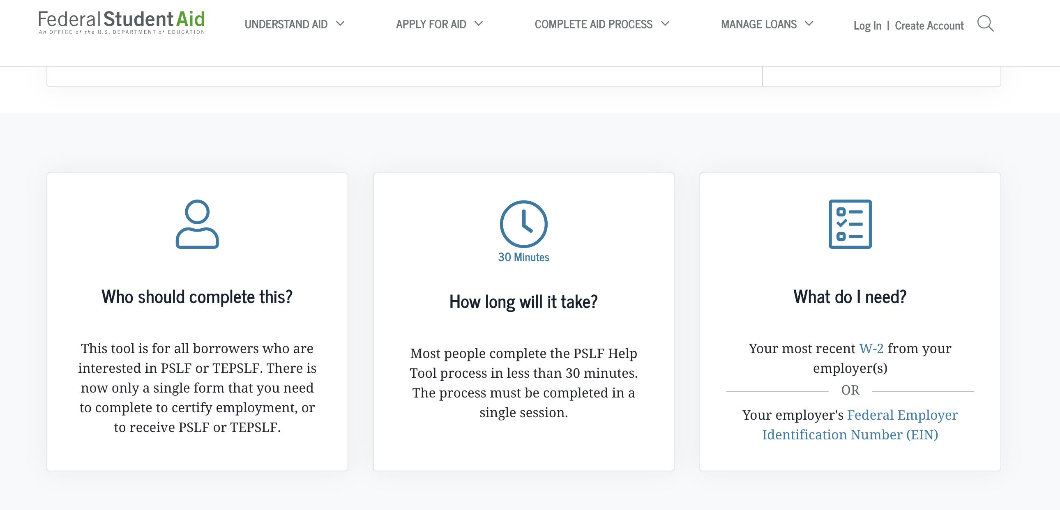
Example: Federal student aid

Slide 17
Clearly state the results and disadvantages of actions, options, and selections
When presenting users with actions and selections, clearly explain the benefits, risks and consequences of each option. This includes any:
changes from what the user asked for,
disadvantages from the standard product or offering,
features that may be a risk to users wellbeing or finances.

Slide 18
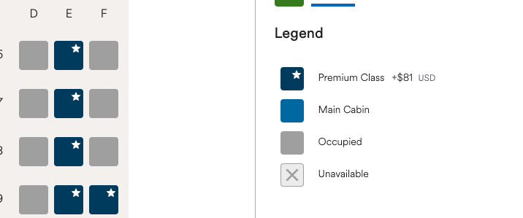

Examples from an airline

Slide 19
Provide alternatives for numbers / numerical concepts.
Provide a description or representation for numerical content such as:
size
quantity
distance
time
date
temperature
positive/negative
calculations
sequencing
percentages.

Slide 20

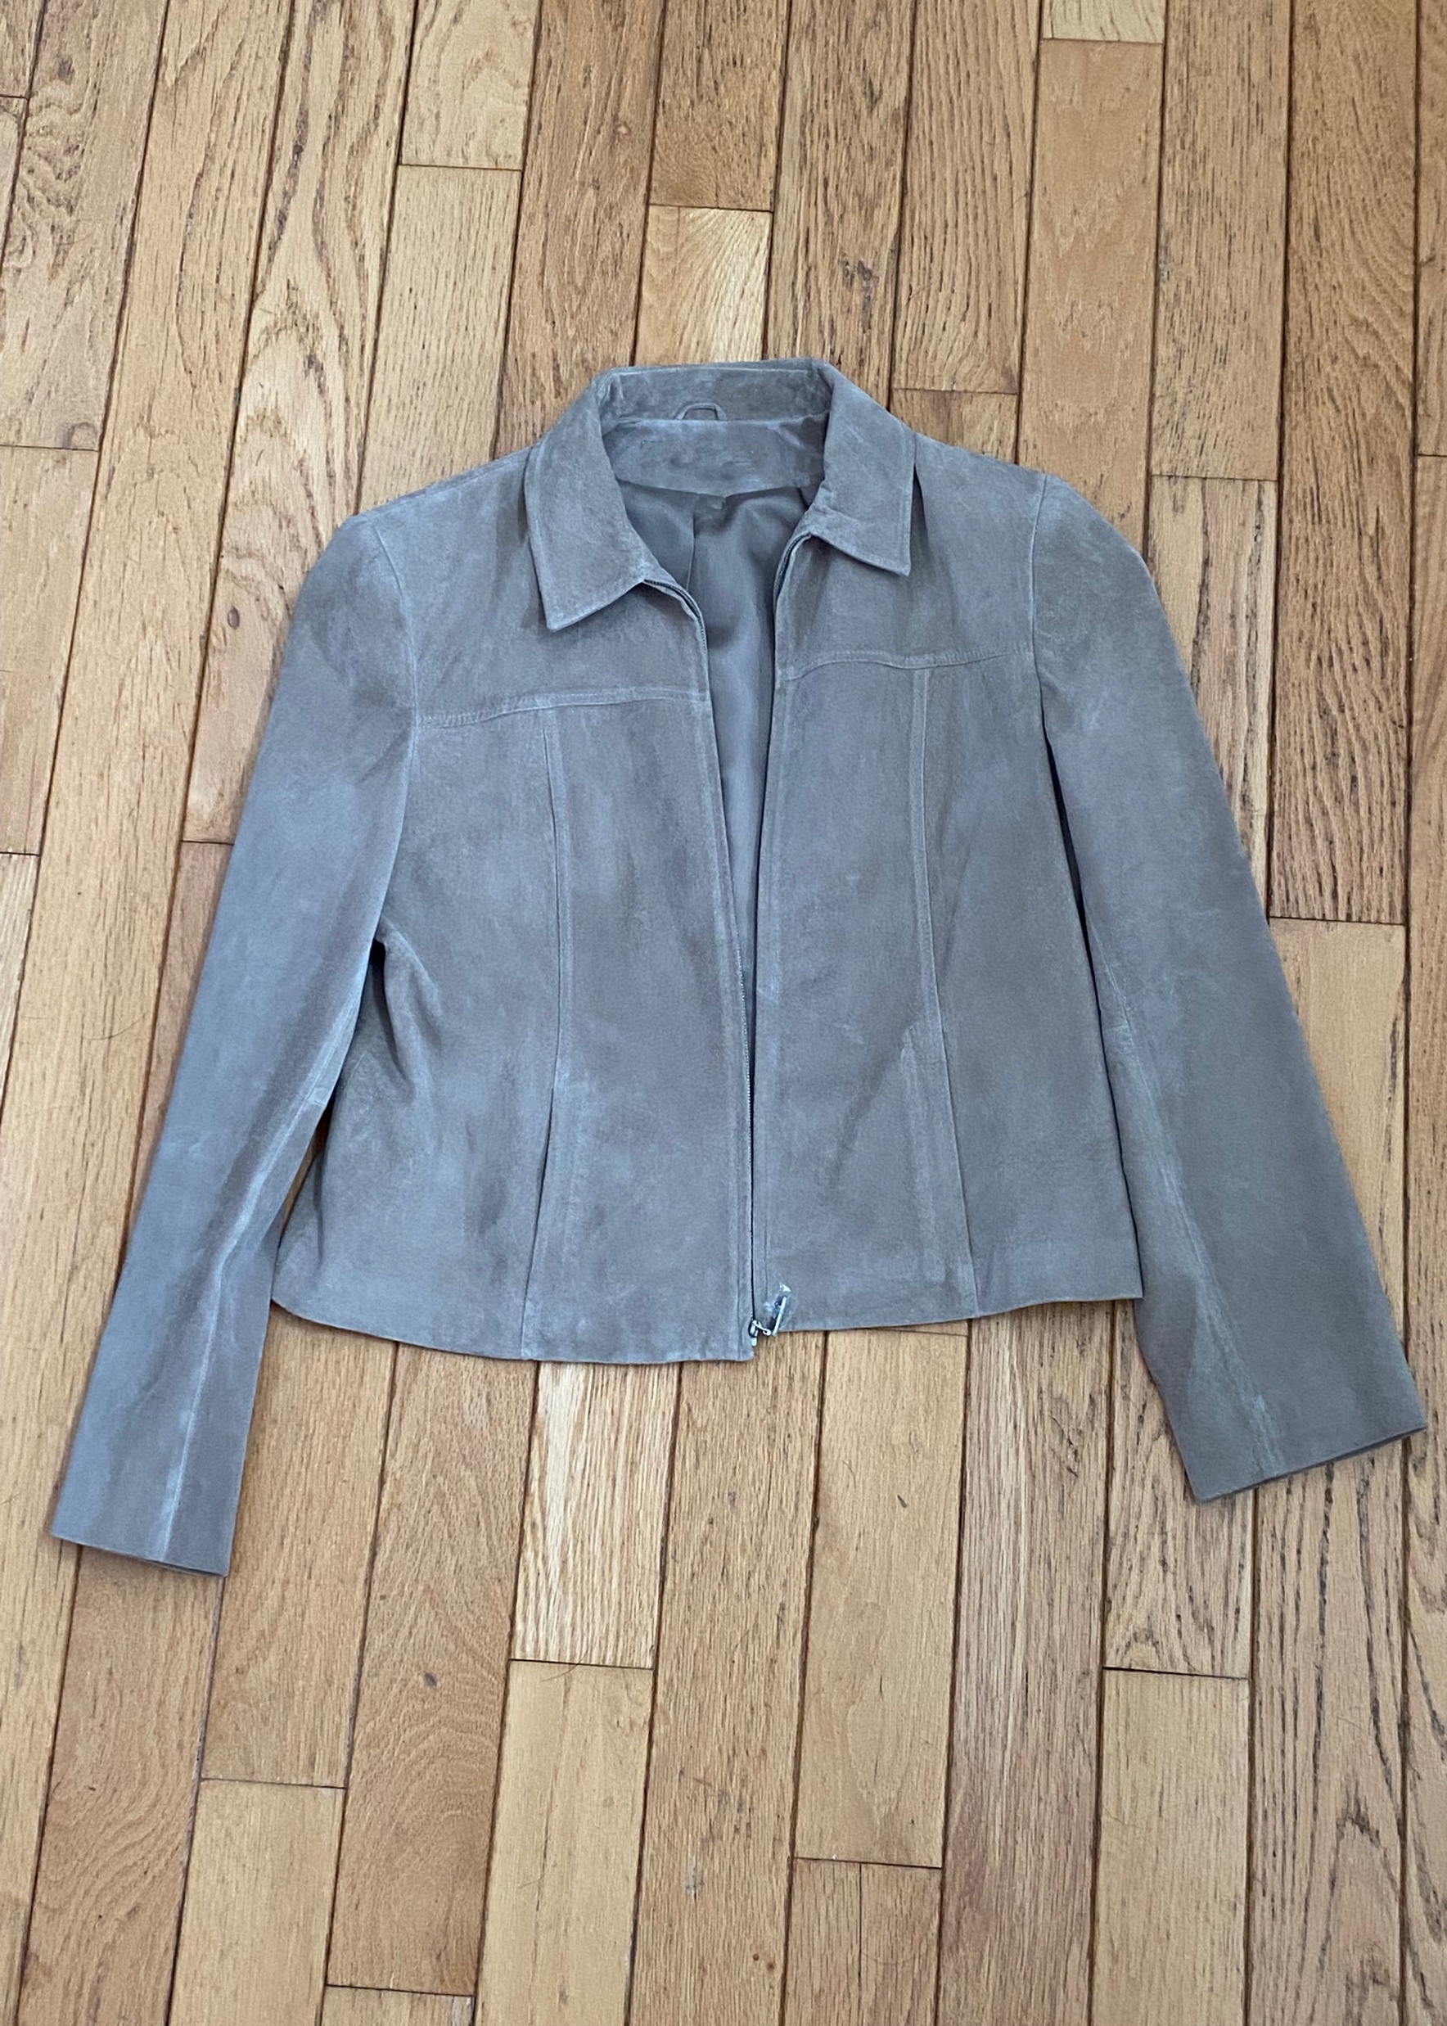
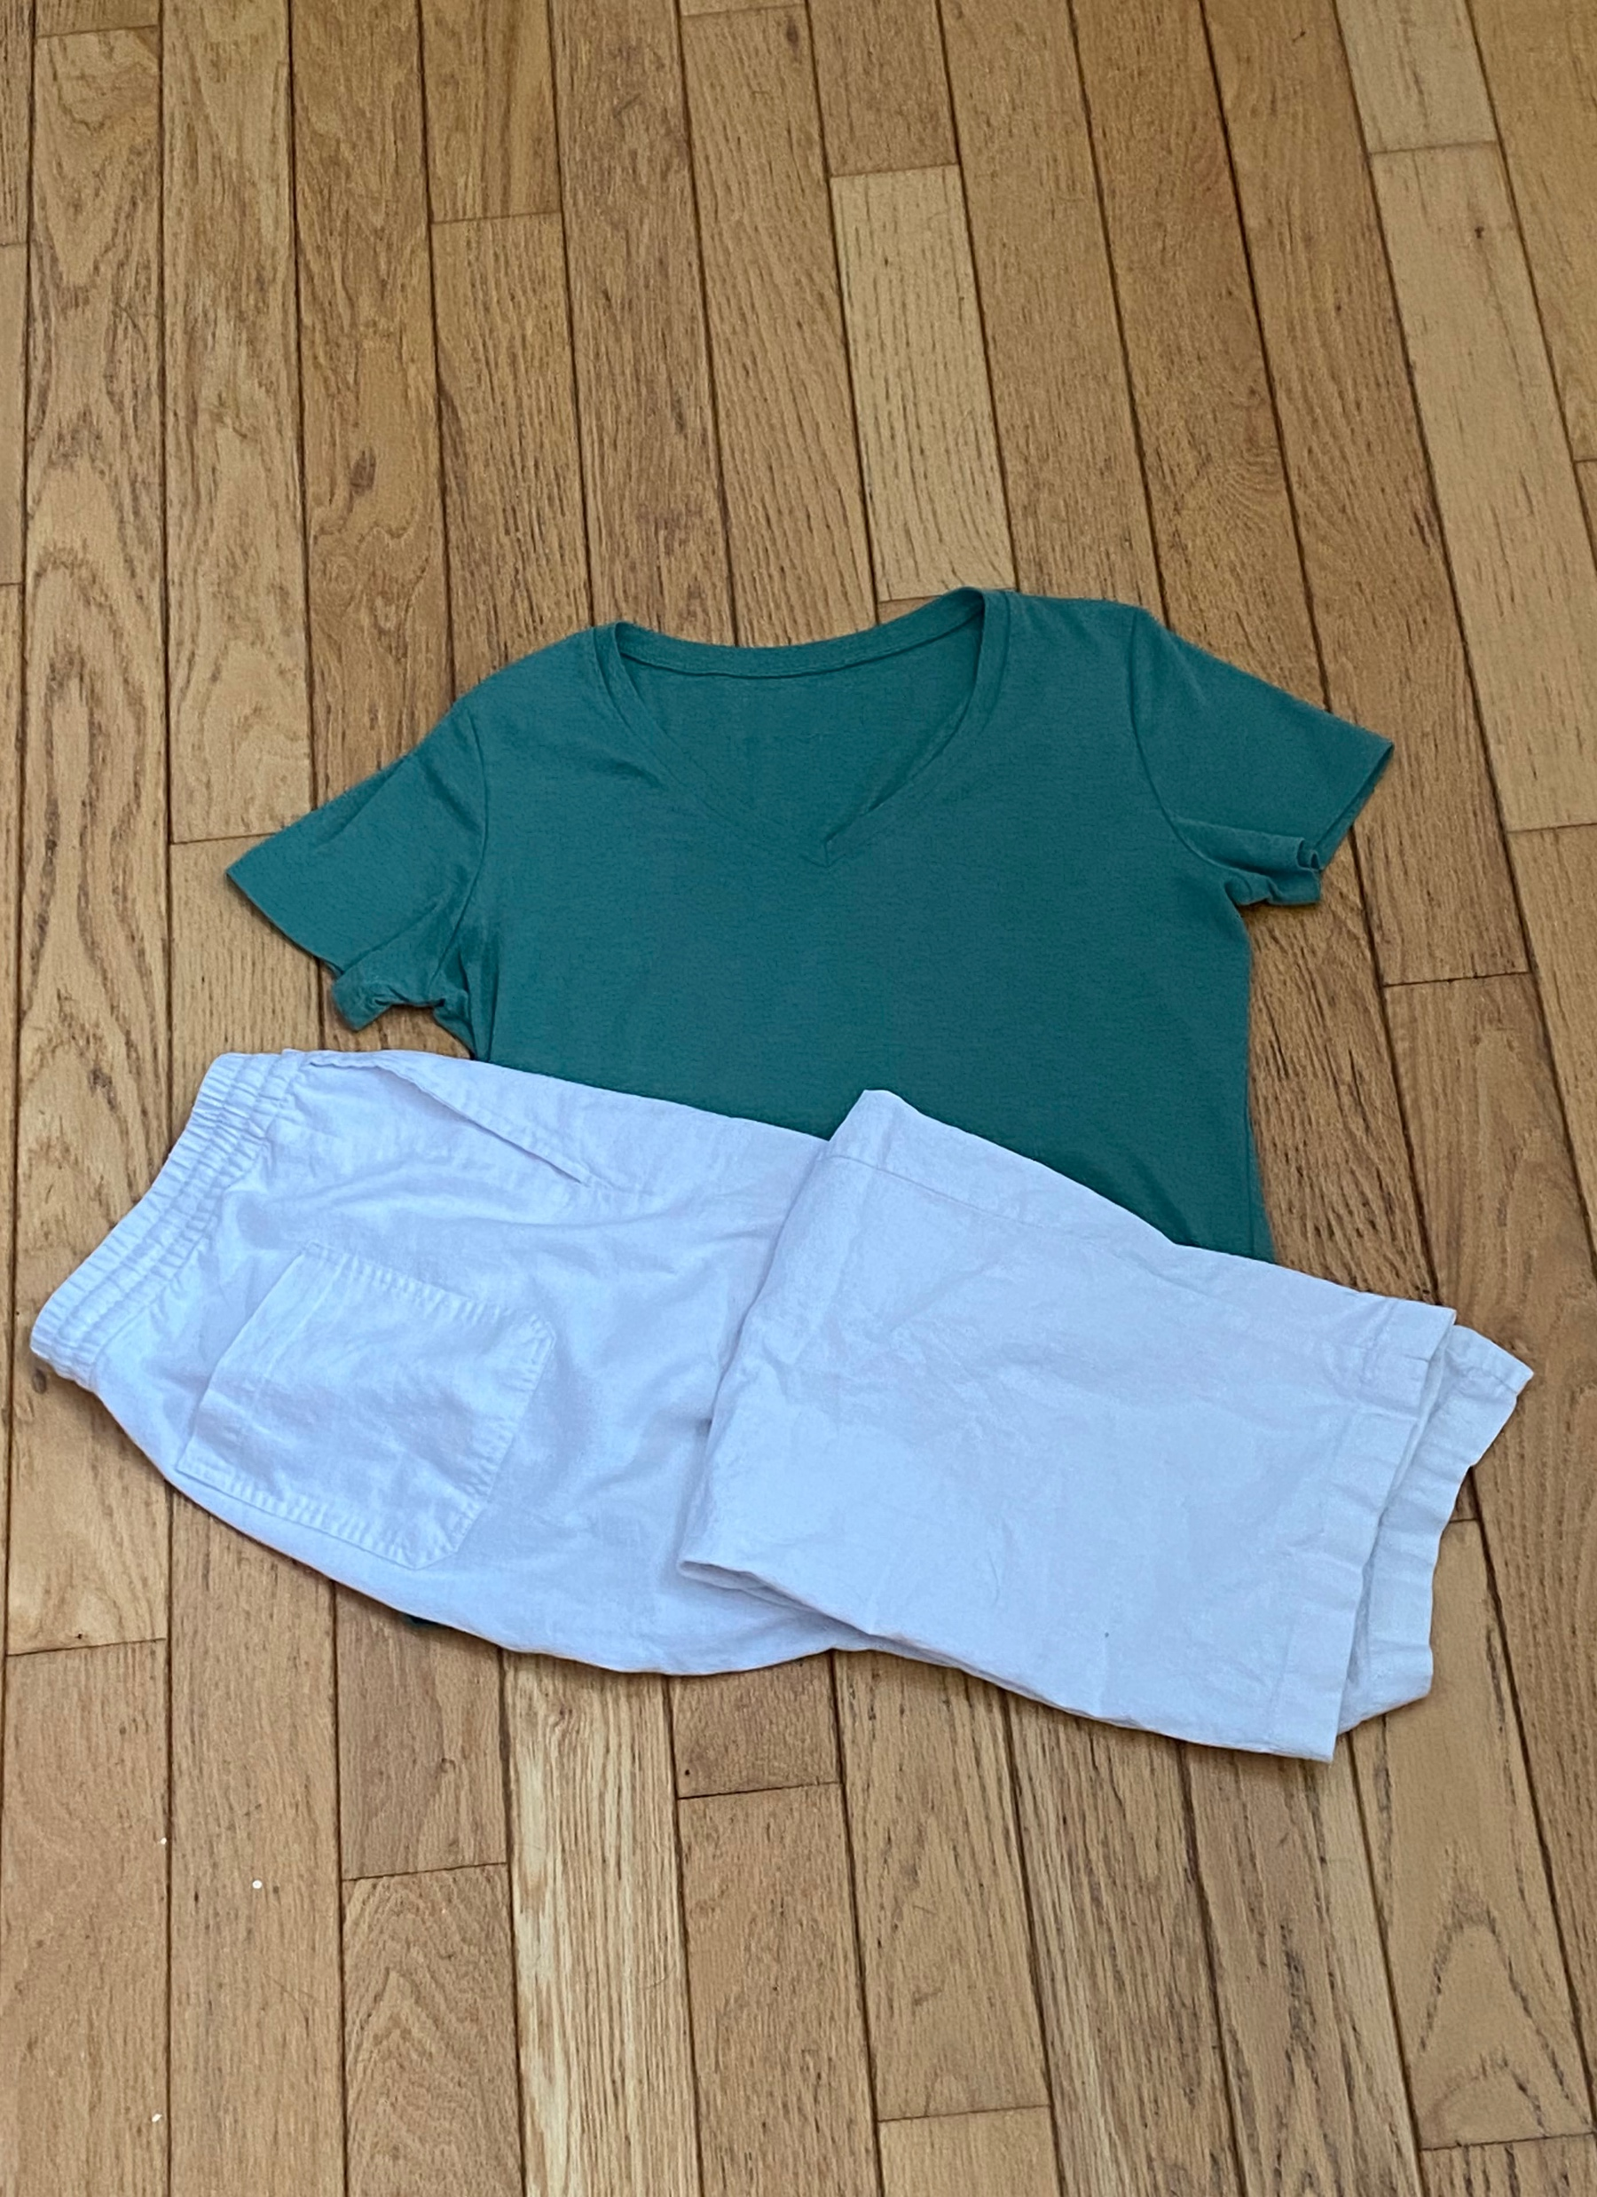
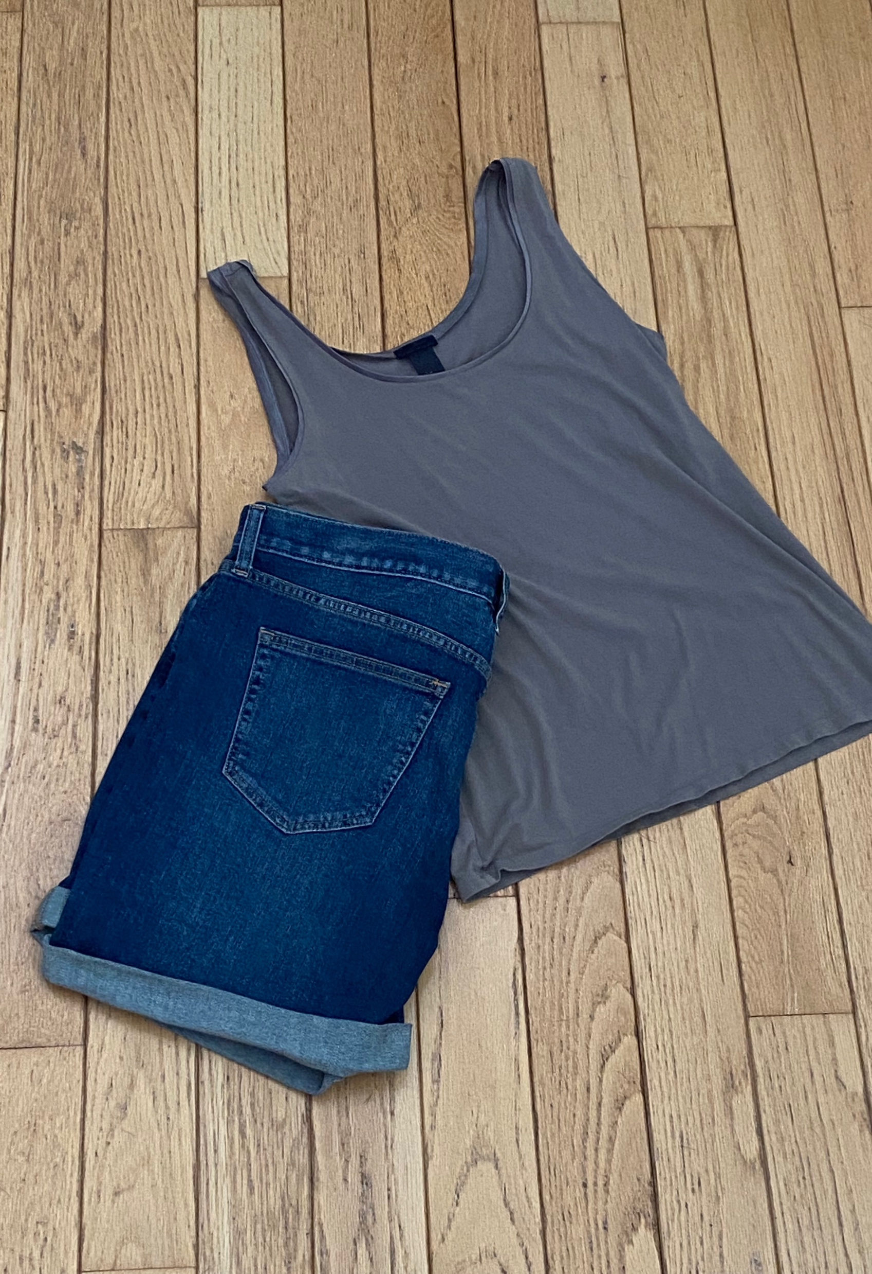
How warm or cold is 272 Kelvin?
272 K | 283 K | 294 K | 305 K
Notes:
Image source: personal

Slide 21
Provide a login that does not rely on memory or other cognitive skills
Users can login, register, and reset credentials, without having more cognitive abilities then they need to use a simple web page.
They do not have to:
memorize character strings,
perform calculations,
copy content,
answer puzzles,
reliably reproduce gestures, or
recognize characters presented on screen, and then enter them into an input field.

Slide 22
Break media into chunks
Provide a logical organization and structure that is easy to navigate.
Divide long pieces of media into segments that are:
logical,
short,
labeled,
easy to identify, and
easy to reach or jump to

Slide 23
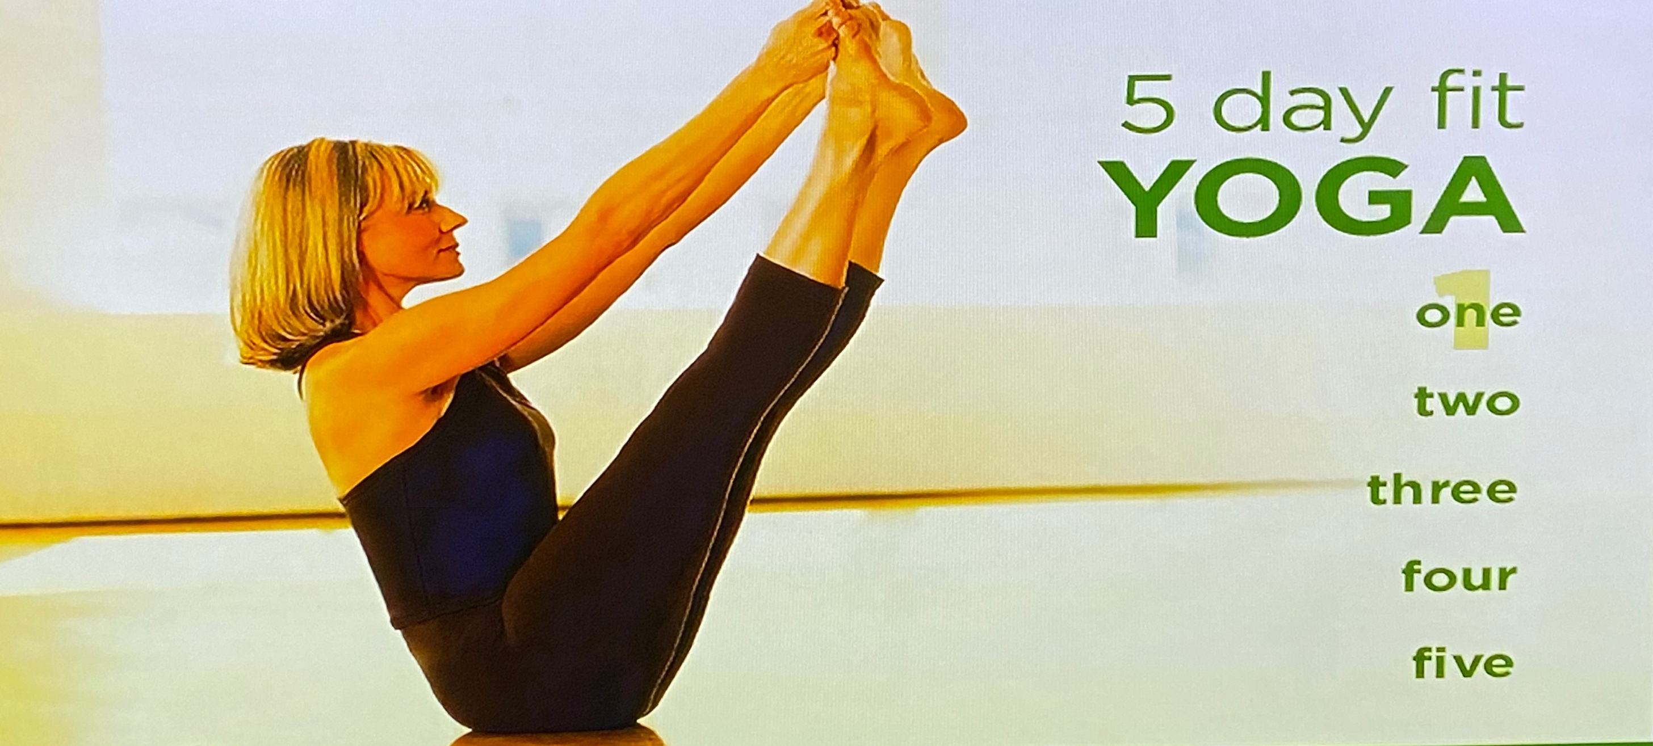
Example: Yoga video
Notes:
Image credit/source: https://www.gaiam.com/pages/gallery

Slide 24
Support a personalized and familiar interface
Provide users with a way to personalize their interface to make it familiar. This can be done by:
Allowing user preferences on presentation such as font style, font size, line heights, margins, and contrast.
Allowing a rollback to a previous interface that the user is familiar with and knows how to use.
Adding semantics on controls, links, and symbols that allow the user to control the experience.
Ensure the user knows the personalization options and can easily configure them. Clear instructions can help.

Slide 25
Design Guide & System

Slide 26
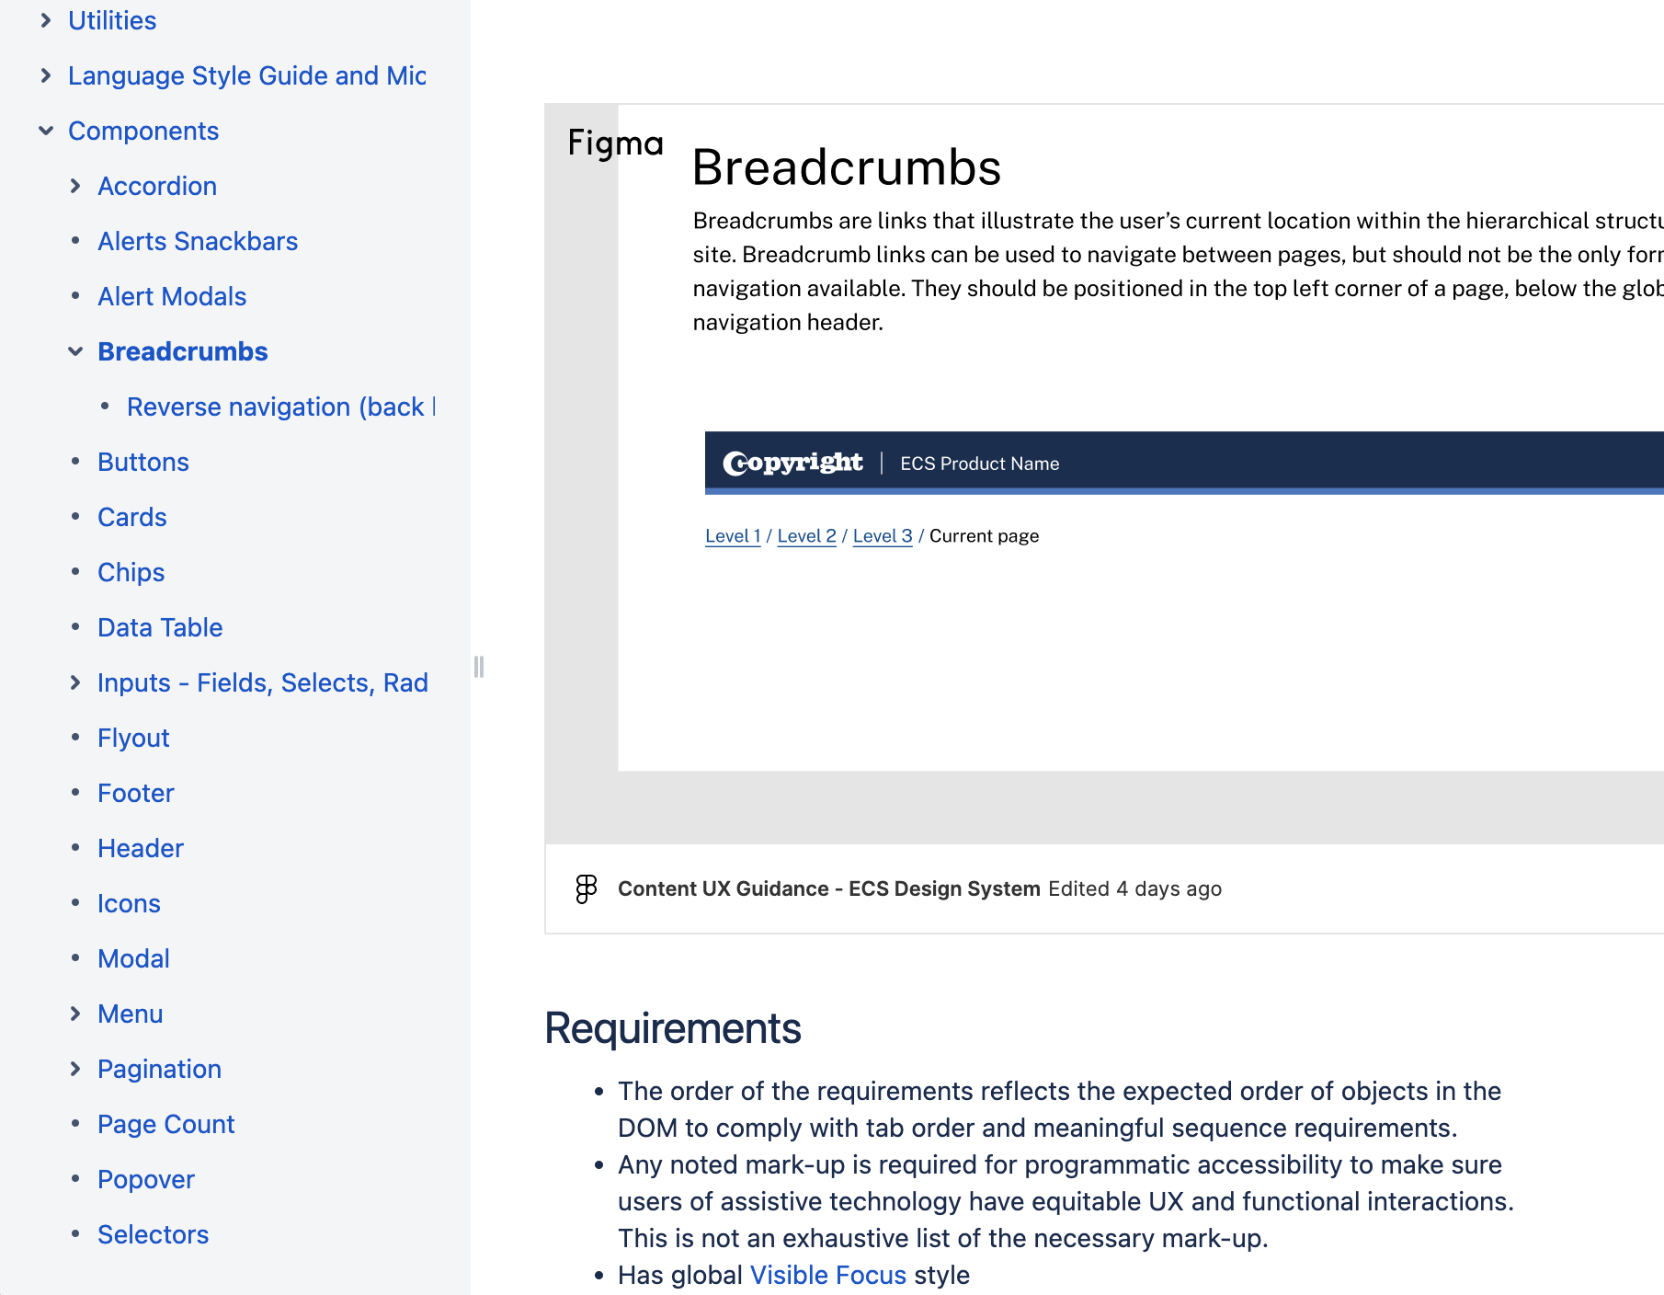
Use design guides & systems to create consistency
Document
Components
Navigation approach
Layouts
Color scheme
Fonts
Icons
Language

Slide 27
Plain language / clear language
Use common words – define uncommon words
Use a simple tense and voice
Avoid double negatives
Avoid nested clauses
Keep text succinct
Use lists for list content
Learn more at: Objective 3: Use Clear and Understandable Content and Plainlanguage.gov

Slide 28
Questions?
Contact Rachael at:
rmontgomery@loc.gov

Slide 29
Next steps
Get a copy of these slides
Read and incorporate Making Content Usable into every stage of your design process
Include individuals with cognitive and learning disabilities in design, development and user testing whenever possible
Try out new ideas, get feedback, and iterate

Slide 30
Additional Personas
Background Slides

Slide 31

Amy: Autistic computer scientist
Problem: Sometimes people use lots of words on web site links that do not seem to make sense. I think they are metaphors, but I’m not sure.
Works well: I put my mouse over items I do not understand and there is some clear text that explains what it did. I would rather they use clear text in the first place then at least I can use it.
Sample User Needs:
Separate each instruction
Use white spacing
Ensure foreground content is not obscured by background
Use Literal Language
Explain Implied Content
Notes:
Her Story
Amy loved her computer science course and now programs in several languages.
She has discovered she can visualize the outcome of her coding and is quick to find any errors even if they are not highlighted.
Writing documentation is less fun and she is too concise.
This means some users do not receive enough help using her applications.
Amy is always concerned about communicating clearly. She finds it hard when people ask her to create a design that includes abstract imagery. Images that do not directly represent something make Amy feel uneasy. She tends to ask if there can be some explanatory text in case other users are confused. Figures of speech where someone has written something that is not literal make her wish that the writer would use easy to understand language as it is hard to understand concepts such as, "the wheels of justice turn slowly".
Image credit: Christina Wocintechchat on unsplash

Slide 32

Yuki: A yoga teacher who has AD(H)D
Problem: As a slow reader it takes me ages to read through badly structured text and I often miss important information.
Works well: The newsletter has headings so I can find the important information quickly.
Sample User Needs:
Break media into chunks
Provide summary of long documents and media
Limit interruptions
Avoid too much content
Provide information so a user can complete and prepare for a task
Make short critical paths
Notes:
Her Story
Yuki found concentrating at school difficult.
When she got into college and started taking a course in business studies life became even more stressful. She knew she could cope with the studies, but never seemed to get her work completed on time.
She found it hard to start a report and even to create a plan for a project.
When working with others she always had good ideas but somehow they were never taken up. She became frustrated, often failing to keep her feelings in check.
Luckily, a tutor suggested she look for help.
When a psychologist mentioned Attention Deficit Hyperactive Disorder or AD(H)D, Yuki was relieved to have a reason for her planning and organizational difficulties and other executive functions.
She did not want to draw attention to her difficulties, but knowing what caused the challenges helped her find solutions. She learnt that if she could make use of her constantly active brain and body as well as manage her time better, she could turn her hobby into a very successful Yoga business.
Image credit: Yayan Spoian on unsplash

Slide 33
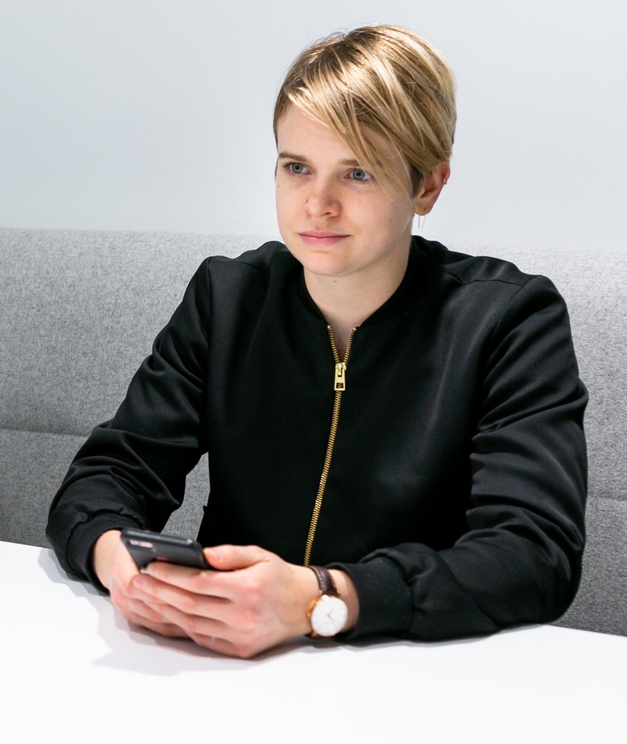
Tal: Student with dyslexia, impaired eye hand coordination
Problem: As a slow reader it takes me ages to read through badly structured text and I often miss important information.
Works well: The newsletter has headings so I can find the important information quickly.
Sample User Needs:
Make it easy to find the most important tasks and features of the site
Make it easy to find the most important actions and information on the page
Provide a login that does not rely on memory or other cognitive skills
Allow the user a simple, single step, login
Provide a login alternative with less words
Notes:
Their Story
Tal has been a student in Israel for the past year. Tal's Fashion Design course is challenging but fun.
Tal loves the creative aspect of the diploma where there is more drawing than writing.
Tal has moderate dyslexia, resulting in times when it is hard to cope with complex text.
Tal sometimes finds it a challenge working out how words are pronounced when they have many syllables. This can make it hard for Tal to grasp the meaning of some paragraphs.
They often have to reread content.
Tal has several projects to complete as part of the Fashion Design portfolio requirements. The one that worries Tal most involves a written assignment to research post-war fashions and their impact on today's designs.
Image credit: mapbox on unsplash

Slide 34
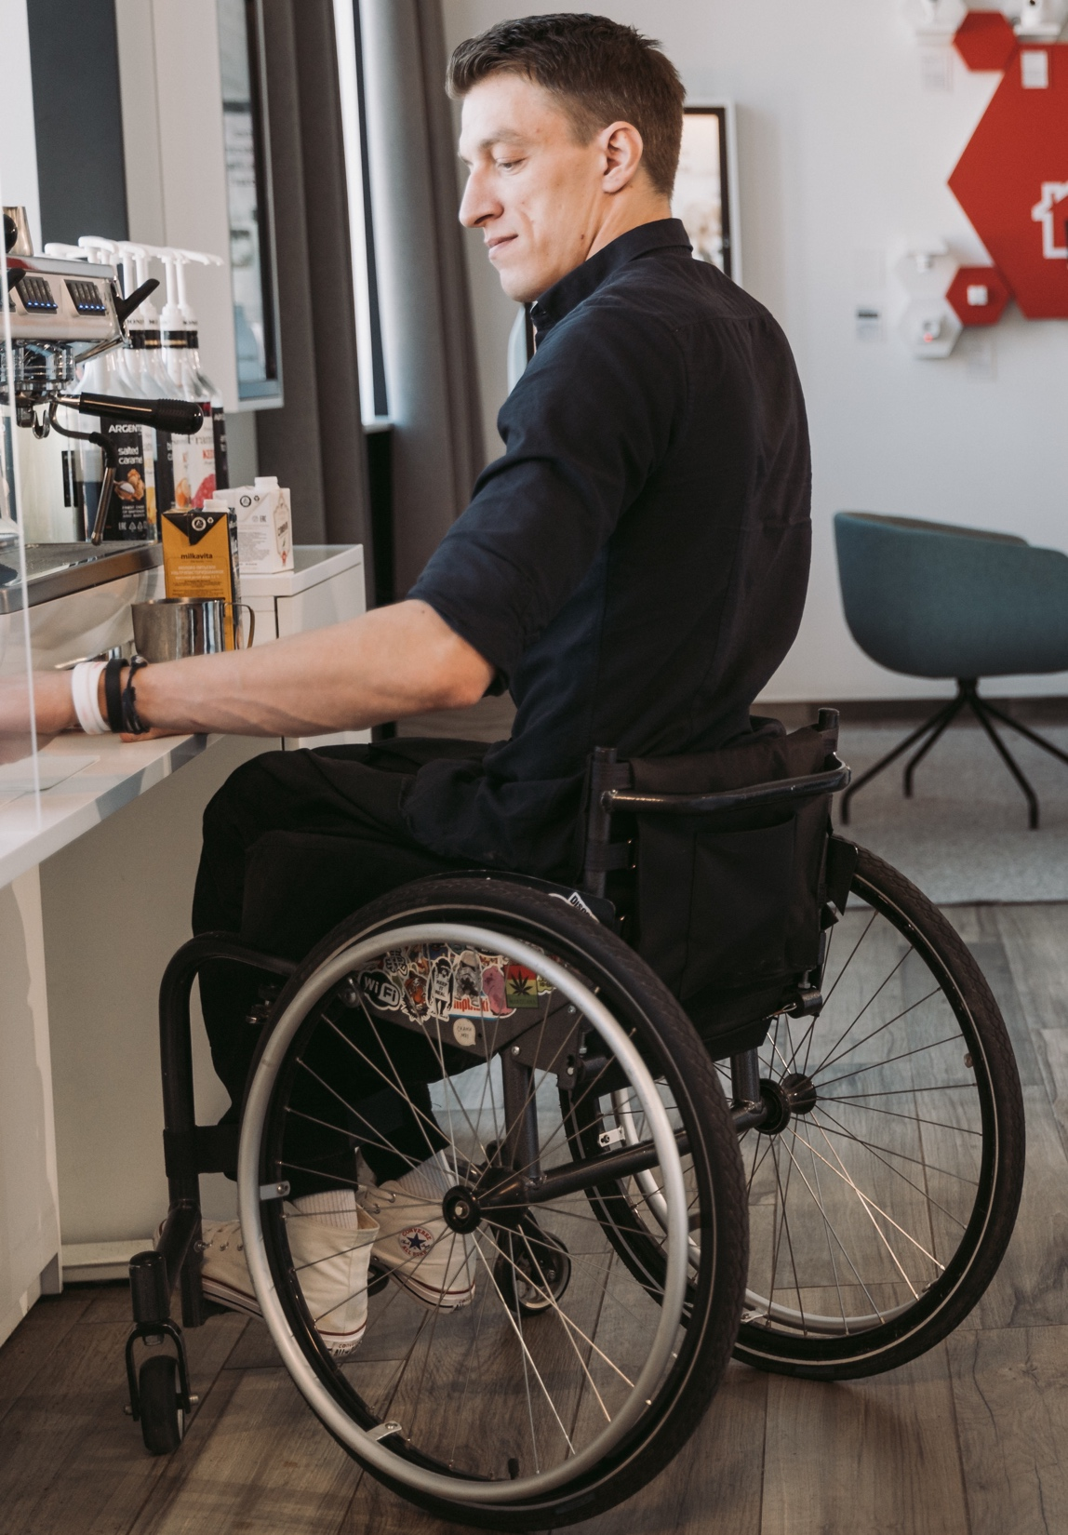
Sam: Librarian who has a hemiplegia and aphasia
Problem: Long sentences are hard, too many strange words, and I get lost.
Works well: I like simple short sentences with easy words.
Select Design Patterns:
Use clear words
Use a simple tense and voice
Avoid double negatives or nested clauses
Use literal language
Keep text succinct
Use clear, unambiguous text formatting and punctuation
Explain implied content
Provide help for forms and non-standard controls
Separate each instruction
Notes:
His Story
Sam loved his work as a librarian. He spent his entire life surrounded by books in peaceful places where he could research his love for history.
In recent years, he enjoyed using the web to explore how other people around the world saw the history of his own country and the changing views on famous people from the past. Now he is depressed and very frustrated due to a recent stroke.
The right side of his body is paralyzed.
He also has difficulty having conversations with friends and family due to aphasia. To him this means that some of his words are muddled and his understanding is not always as clear as it has been.
Worst of all, he cannot read as fluently as he has in the past. One-handed typing is slow and he finds his word finding abilities often fail him.
Hemiplegia – partial paralysis Aphasia - loss of ability to understand or express speech, caused by brain damage.
Image credit: pexels mart production on unsplash

Slide 35
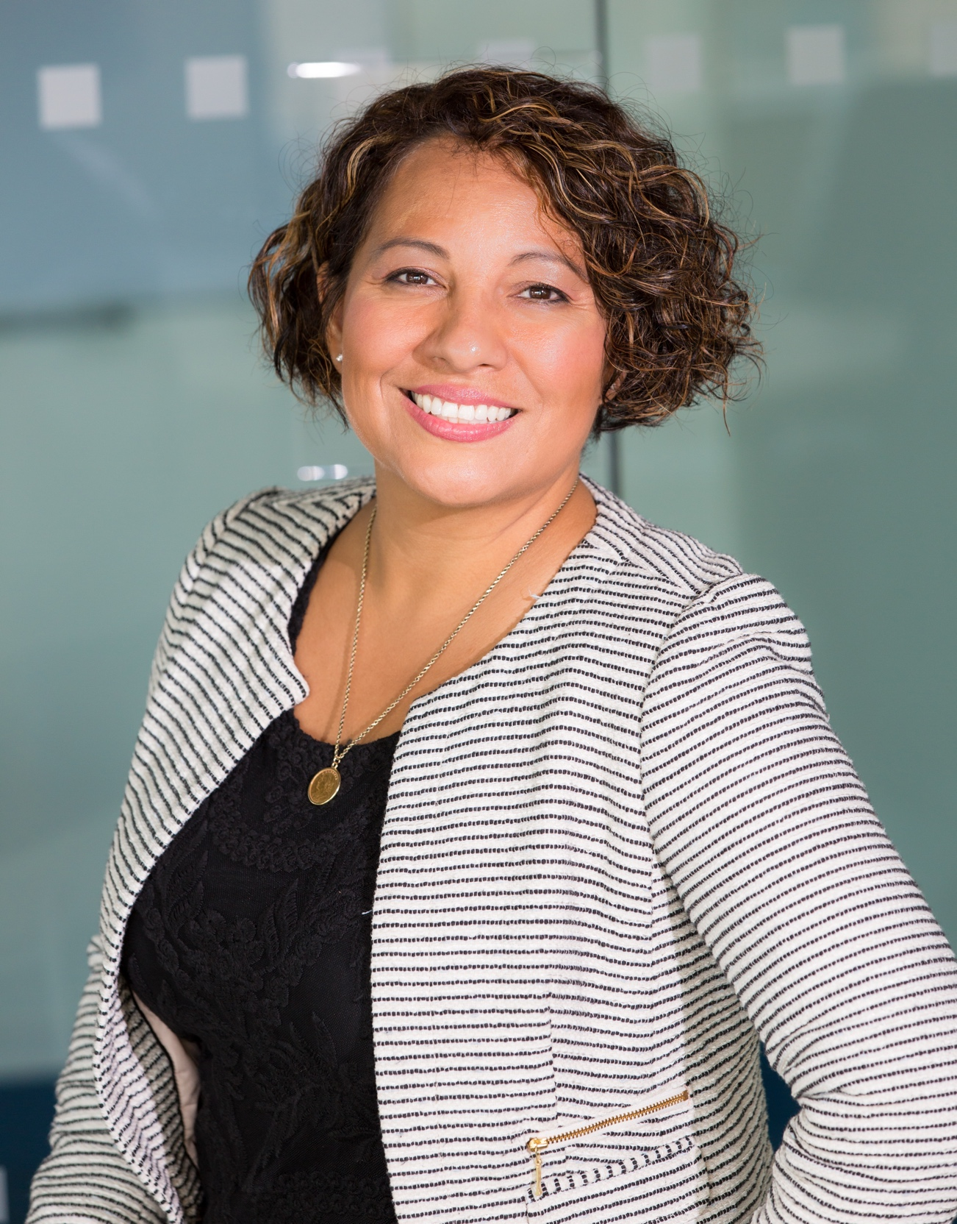
Maria: A user who has memory loss
Problem: When there are lots of buttons or menu items I often make mistakes and press the wrong ones and end up getting frustrated and wasting time.
Works well: I like web sites that allow me to work through a series of instructions and edit boxes one after the other with clear buttons moving me to the next stage.
Sample Design Patterns:
Make the purpose of your page clear
Make it easy to find the most important tasks and features of the site
Make each step clear
Use icons that help the user
Let users go back
Make it easy to undo form errors
Do not rely on users calculations or memorizing information
Notes:
Her Story
Maria is 50 years old, married, and lives with her family in São Paulo, Brazil.
Maria is beginning to lose her memory but still works part-time for a local company.
Maria needs to use websites to gather information and order products. More modern websites with content that changes when the mouse hovers over it are a nightmare! While ordering business cards (a multi-step process), Maria has difficulty remembering information that she enters into previous screens. On the first step she sees content choices that the process expects her to remember in later screens. Additionally, the prolonged mental stress that she experiences while navigating means it is hard for her to make new memories. Processes that require Maria to remember information from one step to another need to give her the information required, at the exact point of use, otherwise she will not be able to complete the process. Because she has hand/eye coordination difficulties, she also often presses something incorrectly.
Image credit: Christian Buehner on unsplash.com

Slide 36
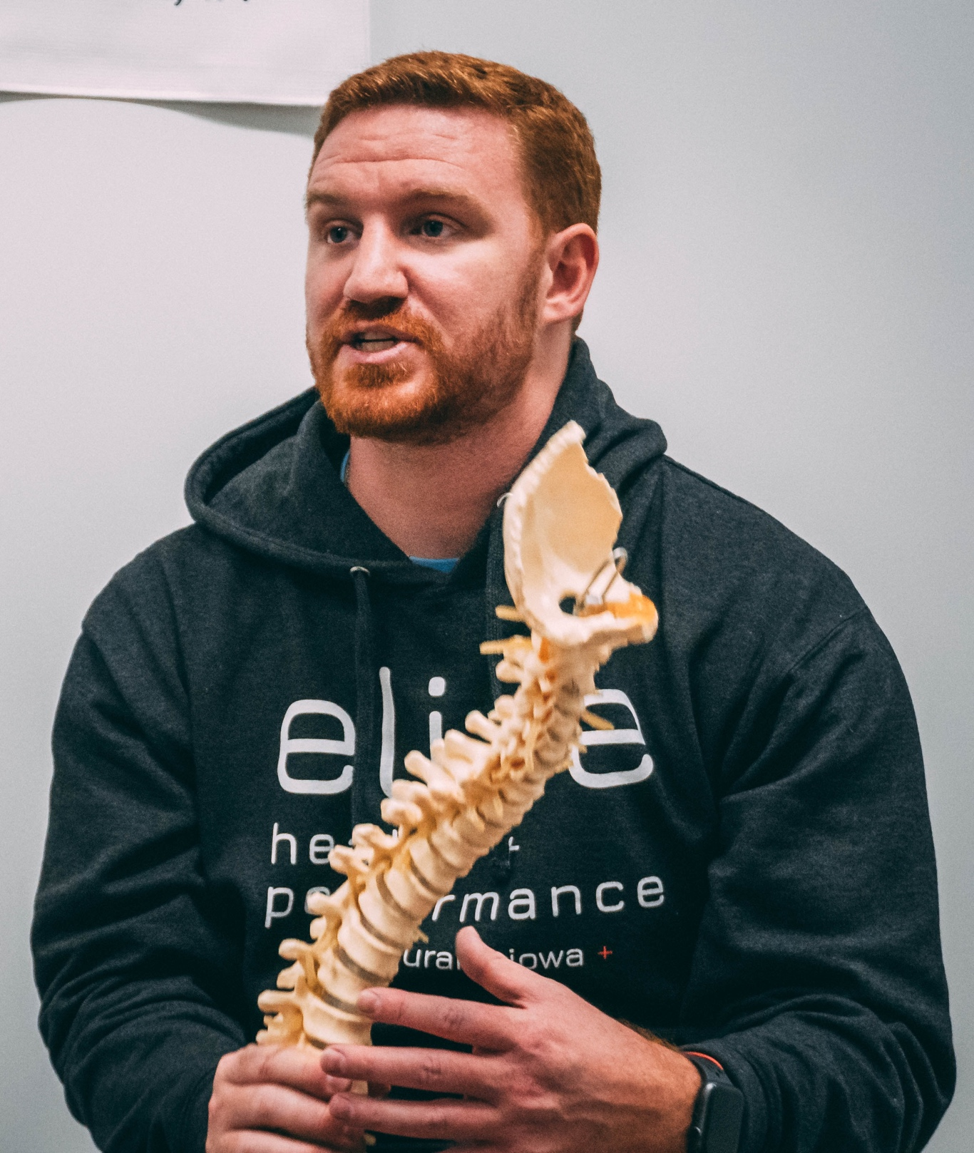
Jonathan: Therapist with dyscalculia
Problem: It says there is a meeting at 15.34 UTH. Now is lunch time. Did I miss it?
Works well: There is a line marker showing what time of day it is now, so I can see the meeting is soon.
Sample User Needs:
Provide alternatives for numerical concepts
Provide a login that does not rely on memory or other cognitive skills
Allow the user a simple, single step, login
Provide a login alternative with less words
Notes:
His Story
Jonathan is a massage therapist with dyscalculia.
Although he is very intelligent in other areas, he has trouble working with numbers and needs to count on his fingers to add very basic sums.
He struggles with concepts like “greater than” and “less than” and understanding how numbers are related to each other, especially ones that end in a series of zeros such as 10, 100, 1000, etc.
It’s hard for him to follow the logic behind mathematical concepts and to do everyday tasks that involve numbers or quantities, like measuring ingredients in a recipe or paying for things in cash
Image credit: Ryan Snaadt on unsplash

Slide 37
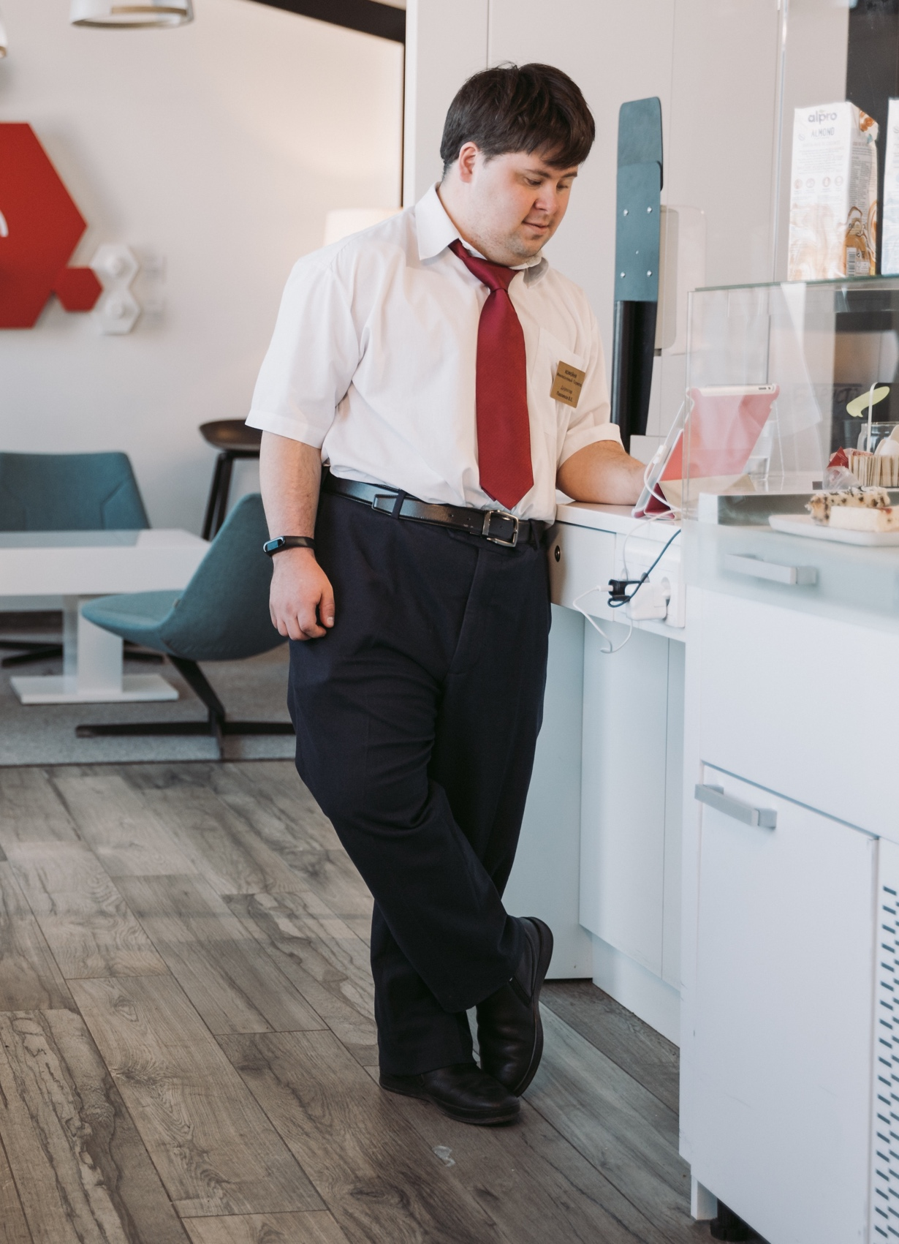
George: User with down syndrome, works in market
Problem: I find it hard to understand and remember long and complex written instructions.
Works well: The instructions for scanning items are presented as a clear list of steps with pictures and easy to understand language next to them. If I get stuck I can quickly find a reminder of what to do with such ‘Easy to Understand’ content.
Sample User Needs:
Use icons that help the user
Support a personalized and familiar interface
Provide alternative content for complex information and tasks
Enable APIs and extensions
Notes:
His Story
George enjoys his job and lives semi-independently in a small town, where he can easily find his way around.
However, George finds it hard to use search engines and navigate around web sites because of the need to work with large blocks of text.
He has problems using the online systems at work, and needs help to search for suitable videos or music.
Image credit: pexels mart production on unsplash

